Slide 1







Introduction to Gen AI: Simple LLM Inference on CPU and fine-tuning of LLM Model to create a Custom Chatbot
Krupa Kori

Slide 2
Contents
Solution
Features Offered
Process Flow
Architecture Diagram
Technologies used
Conclusion

Slide 3
SOLUTION
Create a custom chatbot using a lightweight LLM like GPT-2.
Deploy it on a CPU using frameworks like Hugging Face Transformers.
Optimize for speed with quantization techniques. Implement basic NLP tasks (intent recognition, response generation) using pre-trained models, ensuring efficient, resource-light operation suitable for CPU deployment.

Slide 4







Features
Natural Language Understanding (NLU)
Intent recognition, Entity extraction, Sentiment analysis
Response Generation
Predefined response templates
Dynamic response generation using LLMs
Voice Interaction
Predefined response templates
Dynamic response generation using LLMs
Authentication and Authorization
Predefined response templates
Dynamic response generation using LLMs
Multilingual Support
Language detection and translation
Support for multiple languages

Slide 5


Process Flow
Define the Problem:
Understand the chatbot's purpose and define user scenarios.
Design Conversational Flows:
Use tools like Botmock, Lucidchart.
NLP Model Development:
Train models using frameworks like Rasa, or use pre-built models from GPT-4.
Backend Development:
Develop the server-side logic using Python, Node.js, or another suitable language.
Integration:
Connect to messaging platforms, databases, and other necessary APIs.

Slide 6
Process Flow
Frontend Development:
Build the user interface using web or mobile technologies.
Testing:
Use tools like Botium for automated testing of chatbots.
Deployment:
Deploy using cloud services, containerize with Docker, manage with Kubernetes.
Monitoring and Analytics:
Implement tools to monitor chatbot performance and gather user interaction data.

Slide 7


Technologies Used
Natural Language Processing (NLP)
Libraries & Frameworks: NLTK, SpaCy, GPT-3/GPT-4 (OpenAI), BERT (Google), Transformer libraries (Hugging Face).
APIs: Dialogflow (Google), Wit.ai (Facebook), LUIS (Microsoft)
Machine Learning Frameworks
TensorFlow: Popular for building deep learning models.
PyTorch: Another leading framework for deep learning.
Scikit-learn: For classical machine learning algorithms.

Slide 8
Technologies Used
Cloud Services
AWS: Offers services like Lex for building conversational interfaces.
Google Cloud: Provides Dialogflow for building chatbots.
Microsoft Azure: Has a suite of AI tools, including LUIS and Azure Bot Service.
Databases
SQL Databases: MySQL, PostgreSQL.
NoSQL Databases: MongoDB, Firebase.
Graph Databases: Neo4j (for more complex
relationship-based queries).

Slide 9
Technologies Used
Frontend Technologies
Web: HTML, CSS, JavaScript, React, Vue.js for building web interfaces.
Mobile: React Native, Flutter for mobile applications.
APIs & Integrations
Messaging Platforms: Integration with Slack, Microsoft Teams, Facebook Messenger, WhatsApp, etc.
Voice Assistants: Amazon Alexa, Google Assistant.

Slide 10


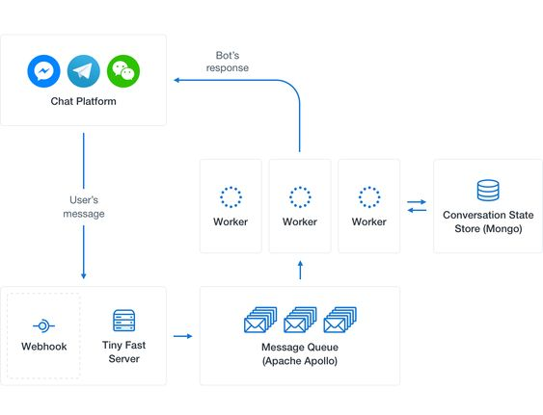
Chatbot Architecture
User Interface (UI): Frontend interface for user interaction (web, mobile, messaging platforms).
Natural Language Processing (NLP): Processes user inputs to understand intents and extract entities (using frameworks like Hugging Face Transformers).
Core Logic: Handles conversation flow, context management, and business logic.
Response Generation: Generates appropriate responses using pre-defined templates or dynamic models.
Backend Systems: Integrates with external APIs, databases, and services for data retrieval and actions.

Slide 11
Conclusion
Creating a custom chatbot involves leveraging natural language processing and machine learning technologies to develop a conversational interface tailored to specific user needs.
By integrating core features like intent recognition, context management, and personalized responses, you can build an efficient, user-friendly chatbot that enhances user interaction and provides valuable support or services.

Slide 12
Thank You
By-
Krupa Kori
4th Sem, AIML
G M Institute of Technology
Davangere

